Slide 1

0 to Infra in 100 Days:
A Nix Speedrun
DEFCON 33
2025
adeci
Start using Nix without all the theory

Slide 2
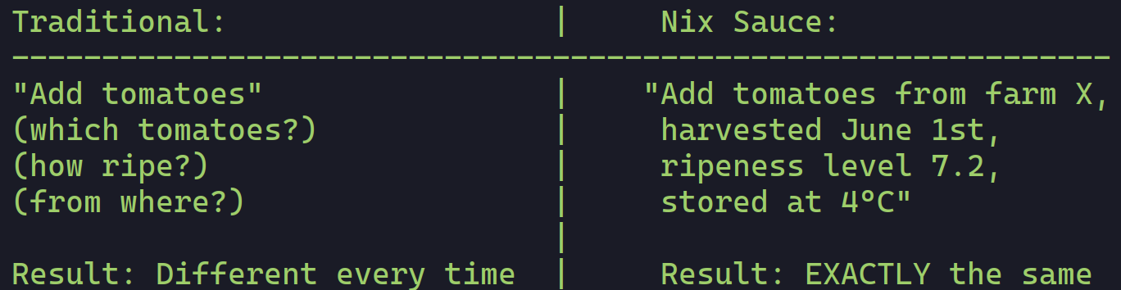
What is Nix?
Why Nix?
DEFCON 33
2025
same inputs = same outputs
Notes:
Show the python27 python311 and nodejs_20 nodejs_22, then show nix run nixpkgs#nodejs_22

Slide 3
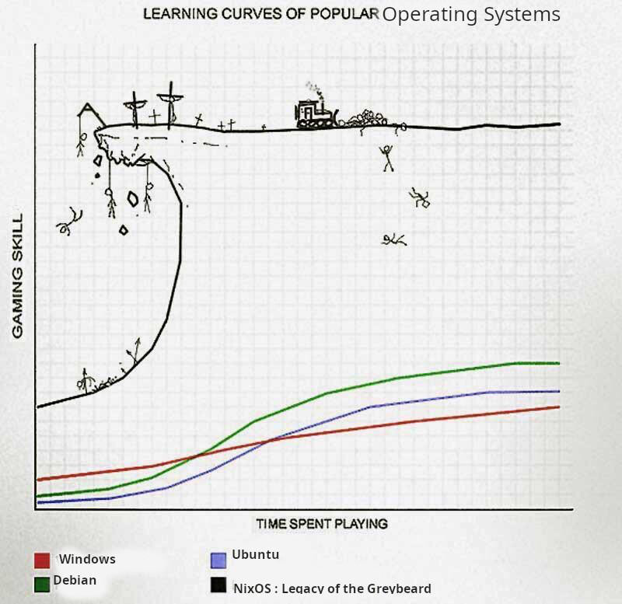
Why does it have to be hard?
DEFCON 33
2025
You can be productive TODAY!
Save mastery for later.
--------------------------
All you need for now:
nix run
nix develop
yoink other people’s shit!
What’s for later:
nix language
complex evaluations
custom packages
Notes:
People compare it to git in terms of beginner complexity vs mastery

Slide 4
Easiest Rule
DEFCON 33
2025
Don’t fight immutability.
avoid most issues!

Slide 5
What does that even mean?
DEFCON 33
2025
Declarative VS Imperative
Imperative
Declarative
A programming paradigm of software that uses statements that change a program's state.
A programming paradigm that expresses the logic of a computation without describing its control flow.
Notes:
Definitions, semantics

Slide 6
What does that even mean?
DEFCON 33
2025
Declarative VS Imperative
Imperative
Declarative
I want a sandwich.
Order it? Make it? I need to do X,Y,Z to get to my sandwich somehow.
Ok I got the bread. Now I got the meat. Cheese? Putting it all together.
I now have a sandwich.
I want a sandwich.
I DECLARE, I have a sandwich.
I now have a sandwich.
Notes:
Definitions, semantics

Slide 7
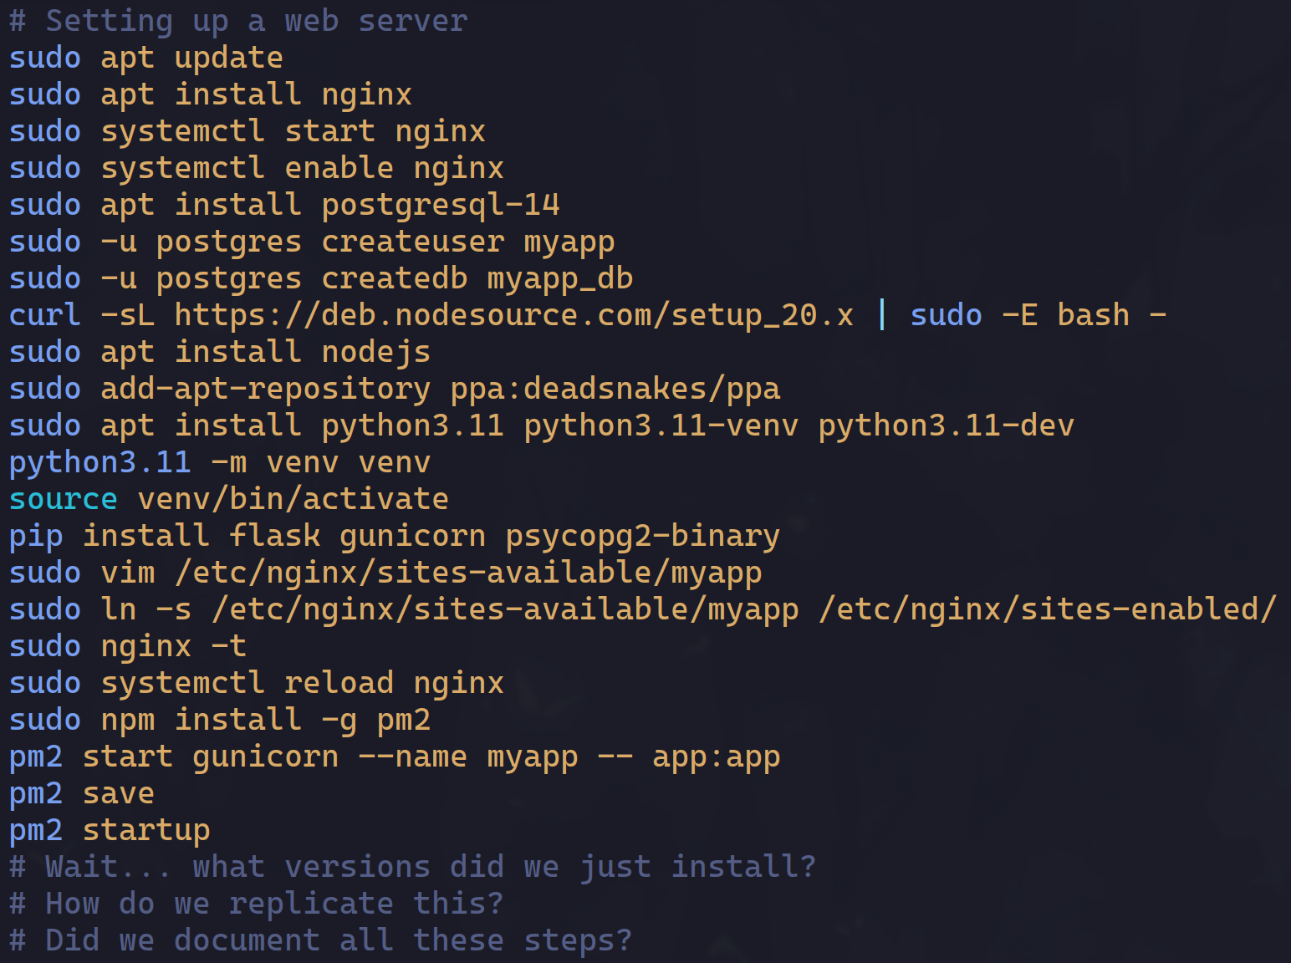
DEFCON 33
2025
Notes:
Do you even know ALL the things installed on your computer?

Slide 8
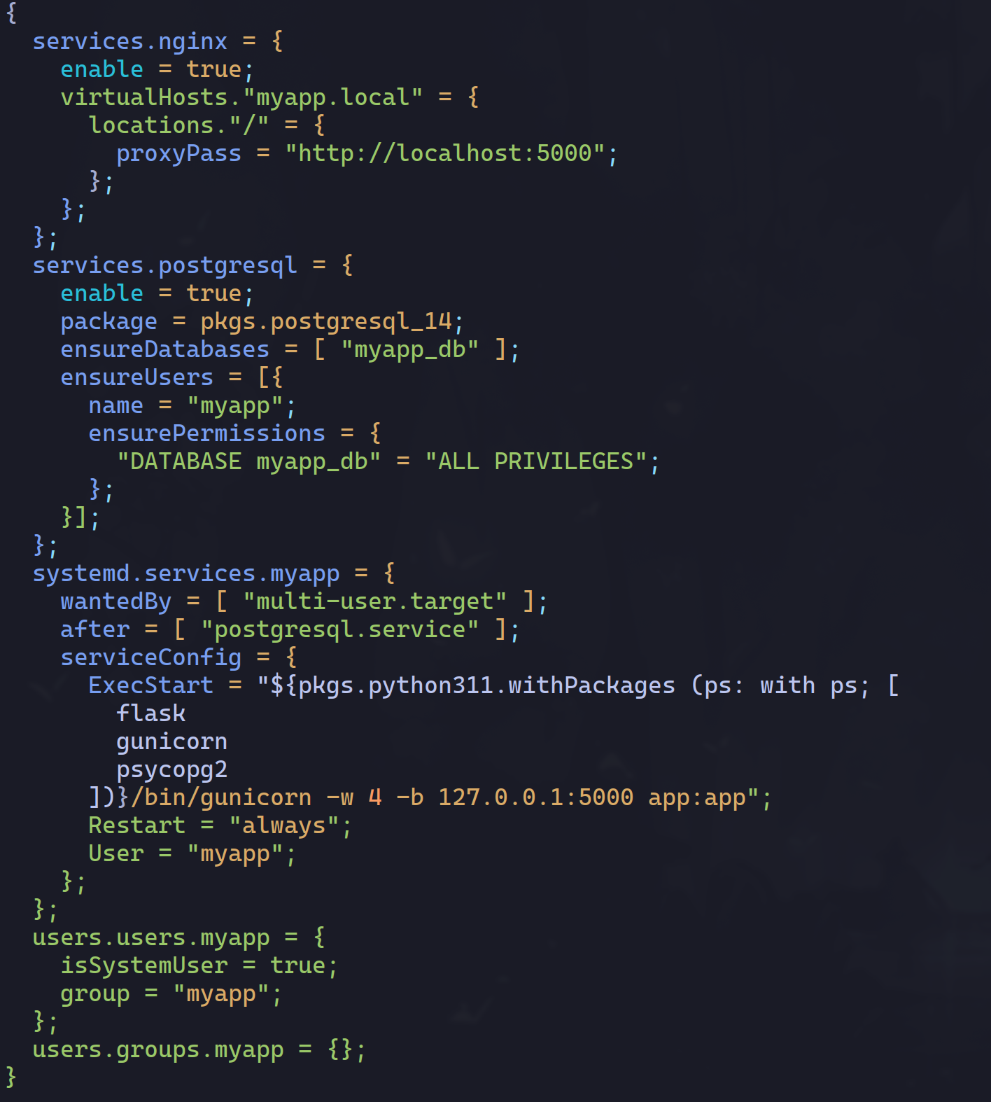
DEFCON 33
2025
Declare each service:
nginx
postgresql
Systemd-service
user to run it!
Same results, every time.

Slide 9
DEFCON 33
2025
nginx
postgresql
systemd
service

Slide 10
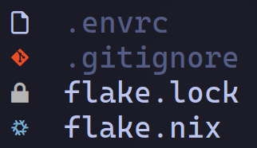
Devshells and Direnv
Your gateway drug!
DEFCON 33
2025
directory is now a fully custom environment?
Notes:
If you take only one thing away from this talk, let it be this

Slide 11

Ok, how does this actually work?
DEFCON 33
2025
lecture speedrun time
derivations
/nix/store
nixpkgs
flakes

Slide 12
derivations = recipes
DEFCON 33
2025
how stuff gets built
Example: GNU Hello program (in nixpkgs so we’ll use that)
hello-2.12.2.tar.gz + gcc + make = RECIPE (INPUTS)
/nix/store/wvfhs8k86740b7j3h1iss94z7cb0ggj1-hello-2.12.2
Notes:
Talk about hashes, show

Slide 13
/nix/store = your pantry
DEFCON 33
2025
where it lives
Excerpt:
0bqhm5fd8i6crnw2vw55v8pjkz6y7nn1-glibc-2.40-66.drv
0bqm7v0fdaiv8fla544mdigcqxnv9wg9-upquote-1.3-tex
0br64qrj17jc33y5dp7jhalgxbnp1h4z-hyprland-0.50.1
0bvf7n3j5cnh250mmh15hgy5cbx3cphp-crate-async-compression-0.4.25.tar.gz.drv
0bwadcra012ilfclxyblvcq1n00fkwfk-subeqn.r71864.tar.xz.drv
0bwdwyc6cpjql8487352ssqpd3kc0qwc-papiergurvan.r73069.tar.xz.drv
0bx5sq0yql80xjlldabjws46lbds7xfh-setup-debug-info-dirs-hook.drv
0bx5070c60awgbsf8jlzxngkayph7yxd-pdfreview-1.2-tex.drv
0byhddlfhbv7chm6dhmscql87mwvc7rl-installkernel.drv
Binary cache (pre-cooked meals), no need to manuall build stuff!
Notes:
Talk about binary cache, no need to compile everything from scratch brand new every time: hashes guarantee security

Slide 14
nixpkgs = fattest cookbook
DEFCON 33
2025
where recipes come from
search.nixos.org
All the secret sauce! The cookbook with SO MANY recipe-generators!
We run: nix run nixpkgs#hello
Nix looks up "hello" in the cookbook (nixpkgs)
The cookbook has a RECIPE-GENERATOR (expression) (NOT the recipe itself)
Nix runs it to generate the actual recipe (derivation) for YOUR system
Asks binary cache: yo do you have what this recipe makes?
If yes, yoink! If not, build it yourself
Put it in your /nix/store!
Notes:
Run nix run github:NixOS/nixpkgs/nixos-23.11#hello and then 25.05 one

Slide 15
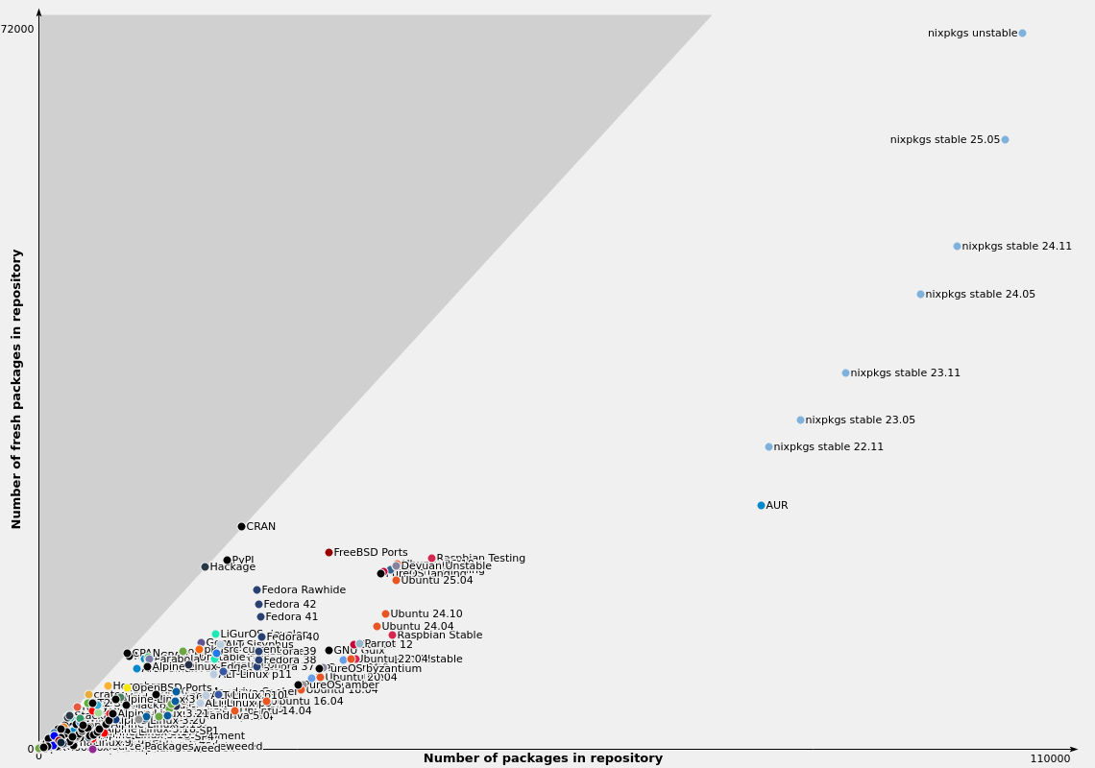
DEFCON 33
2025

Slide 16
flakes
DEFCON 33
2025
the reproducibility solution
Just use flakes bro, all the cool kids use flakes.

Slide 17
DEFCON 33
2025
hello-2.12.2.tar.gz + gcc + make
/nix/store/wvfhs8k86740b7j3h1iss94z7cb0ggj1-hello-2.12.2
Notes:
Talk about hashes, show

Slide 18
DEFCON 33
2025
hello-2.12.2.tar.gz + gcc + make
/nix/store/??????????????????????????????????-hello-2.12.2
nixpkgs
version
+
Notes:
Talk about hashes, show

Slide 19

channels
DEFCON 33
2025
versioning
Example: GNU Hello program again
nix25.05 + hello-2.12.2.tar.gz + gcc + make =
nix24.1 1 + hello-2.12.2.tar.gz + gcc + make =

Slide 20
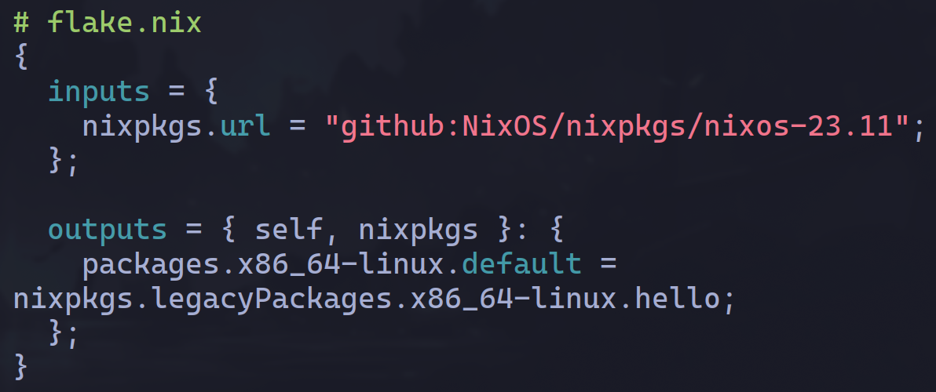
flakes
DEFCON 33
2025
the reproducibility solution - pinning
Just use flakes bro, all the cool kids use flakes.
Returns to “same inputs = same outputs” at the highest level

Slide 21

NixOS
DEFCON 33
2025
let’s take this to the next level
All the previous stuff, but instead of configuring an application/package, you configure your SYSTEM.
Bootloader
Login Manager
Desktop Environment
Secrets
Etc

Slide 22
Thank you!
DEFCON 33
2025
https://github.com/adeci/0toInfra-Talk

